Slide 1
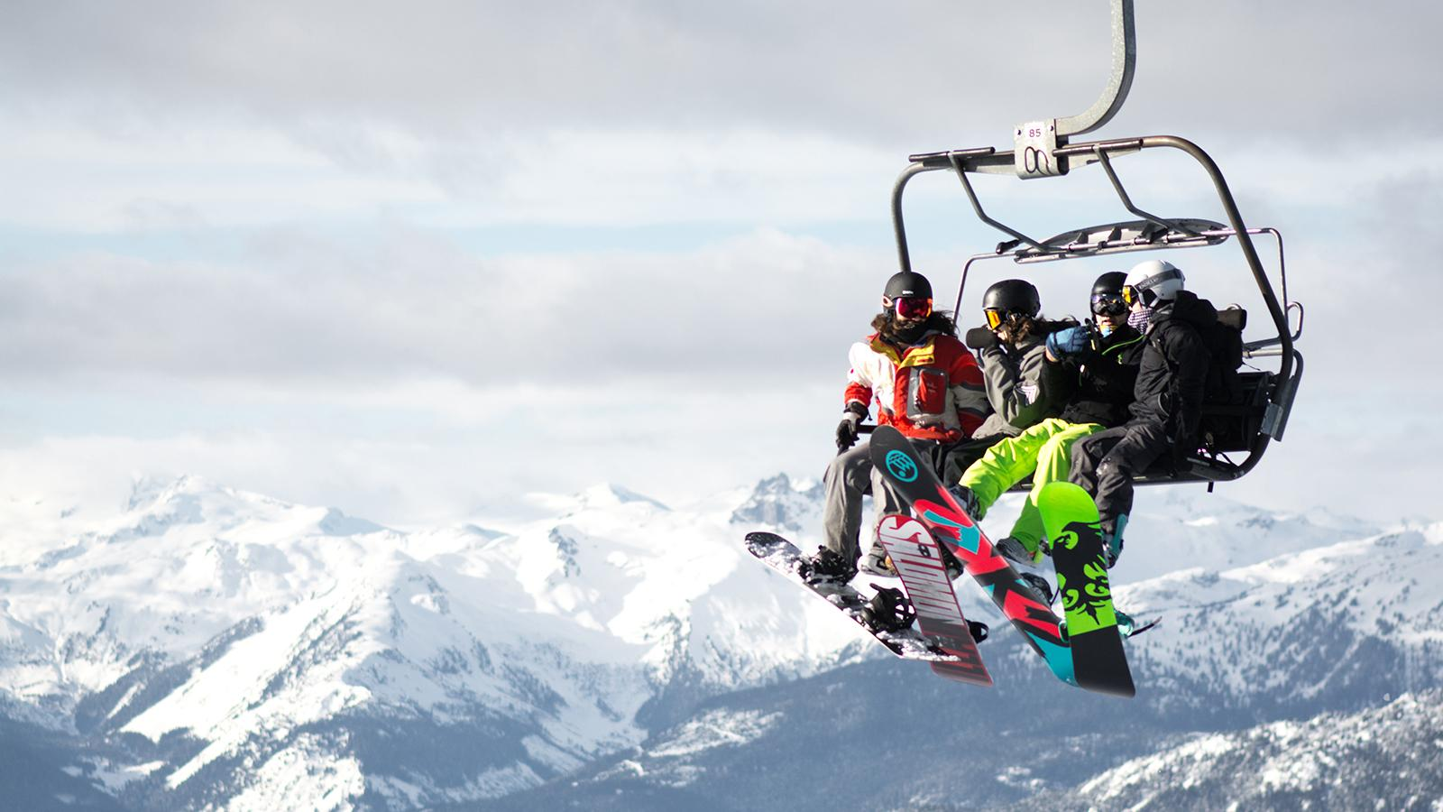
Resort Price Modeling
Big Mountain Resort
This presentation has been designed using resources from PoweredTemplate.com

Slide 2
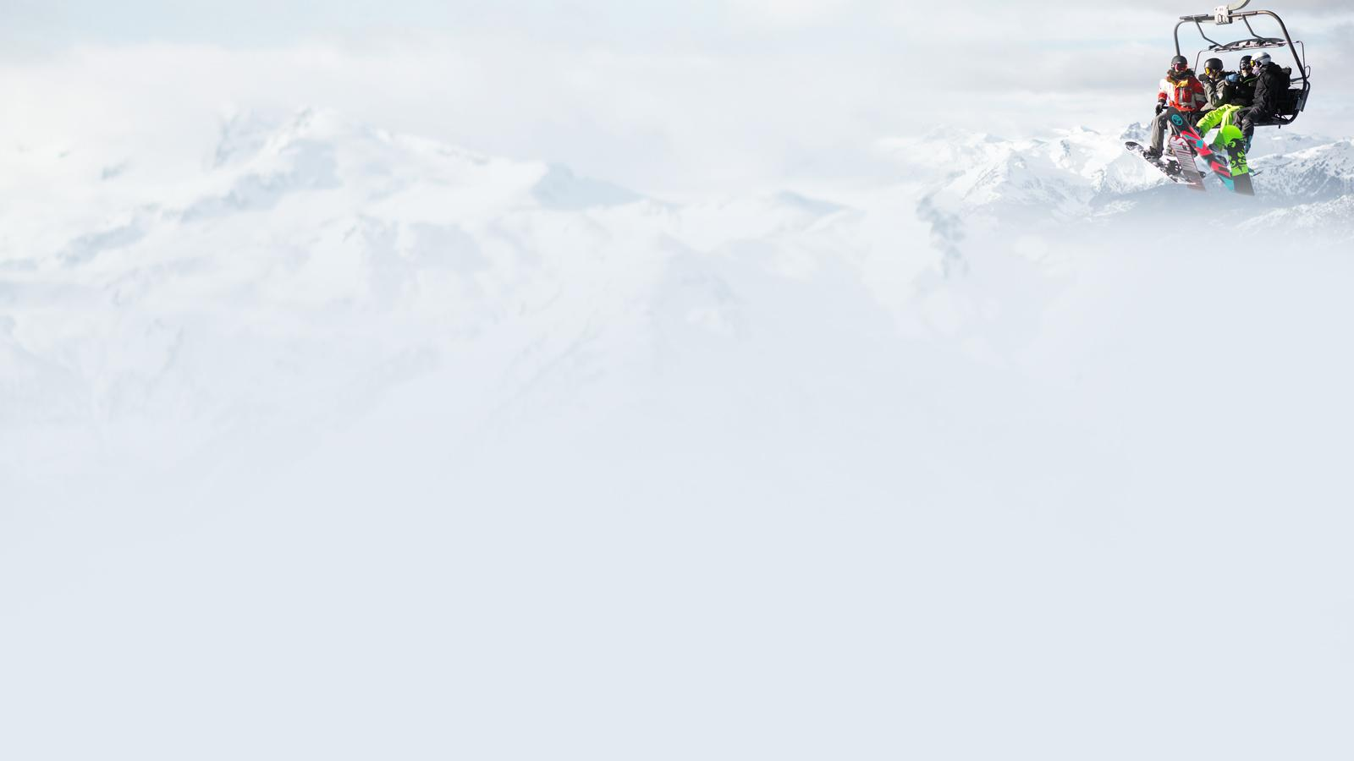
Current Pricing
total revenue
ticket
$81
$141.75 M
avg. stay
revenue per dollar price
5 days
visitors
350,000
$1.75 M

Slide 3
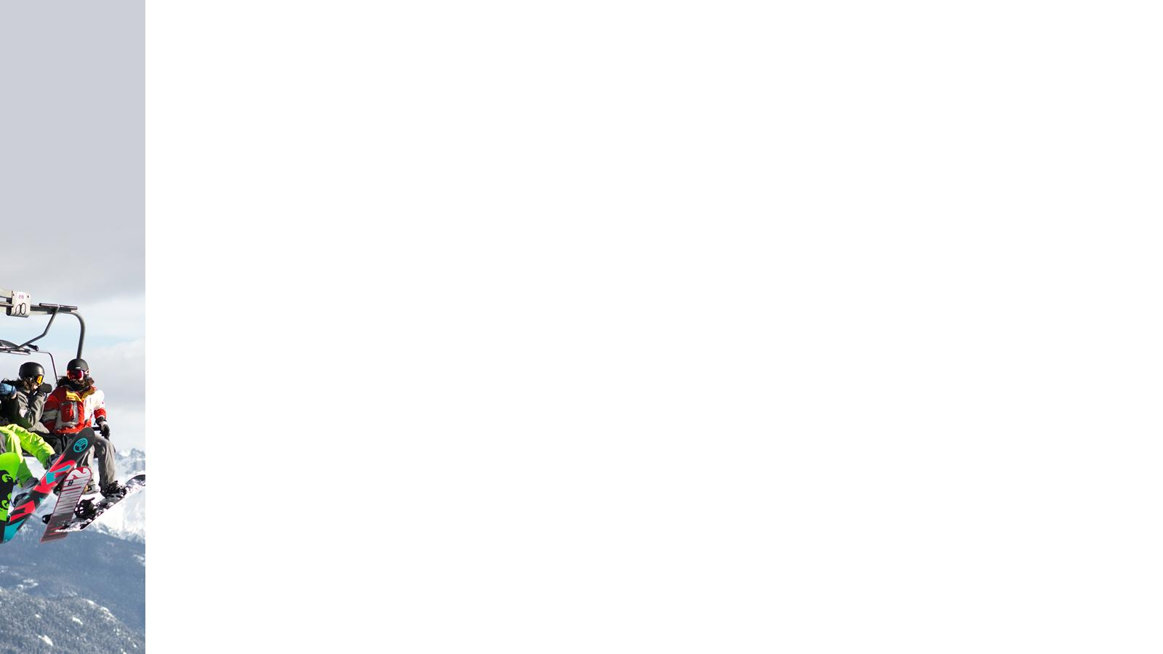
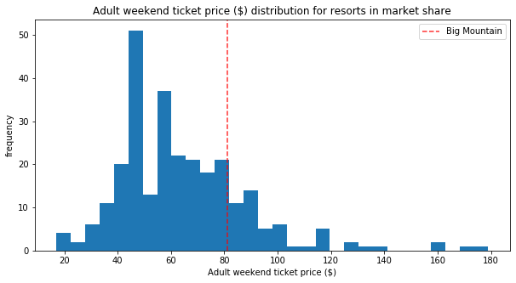
Current Pricing
Notes:
Big Mountain price compared to entire market share.

Slide 4
Problem Identification
Increased operating costs from new lift: $1.54 M
Naive pricing strategy based on market average
No sense of which resort facilities are most valuable to visitors
Do Big Mountain Resort’s current facilities support raising ticket prices by any amount for the coming ski season?
What are the most valuable features for further investment?

Slide 5
Key Findings
The model predicts BMR to have a ticket price of $94
Vertical Drop, Fast Quads, Total Lifts, # Runs, Snow Making, Skiable Area

Slide 6
Data
227 resorts, including BMR (originally 330)
Resort data includes:
region and state
elevation and vertical drop
number and type of each lift:
trams
fast (eights), sixes, quads
regular quad, triple, double, surface
number of terrain parks
number of runs
longest run
total skiable area
snow making coverage
length of last season, predicted next season
years open
average snowfall
night-skiing area
adult weekend (and weekday) ticket price
State data retrieved from Wikipedia:
population
area
Calculated statistics:
resorts per state
resorts per state capita
resorts per state area
% share of state’s skiable area
% share of state’s total days open
% share of state’s terrain parks
% share of state’s night skiing area
Notes:
summary of all data used for the model. Note over 15% of resorts were dropped because of missing weekend price info. Fast 8s and weekday ticket prices were disregarded.

Slide 7
Modeling Results
predictor | R² | Mean Absolute Error | Mean Squared Error
mean | 0.0 | 19.13 | 581.43
model | 0.64 | 10.4 ± 1.5 | 182 ± 57
Notes:
Not important to understand exactly, just a comparison to see if the model is a better predictor. Note R2 should approach 1, average MAE and MSE over cross-verification should be as low as possible, with low standard deviation

Slide 8
Modeling Results
Current Price
Model Predict
$81
85
90
$94
100
105
Mean Absolute Error
Notes:
Shows range of reasonable predicted price. Mean Absolute Error ~10.5, standard deviation over cross verification ~1.5.
Also mention potential uncertainty of the data: assuming other resorts are priced based on features. Knowledge of the market will be helpful to decide if/how much to raise price.

Slide 9
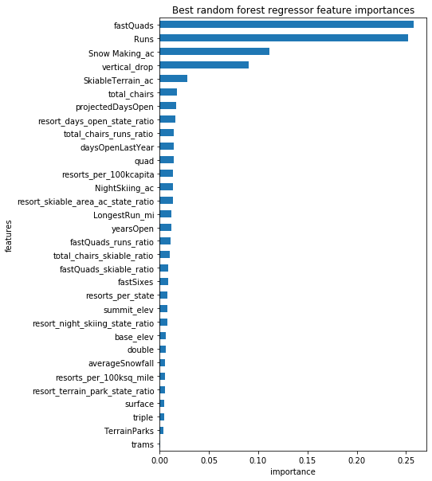
Modeling Results
Notes:
Most important features to our model (top 6). Note 2 other important features identified by the linear regression model: longest run and trams

Slide 10
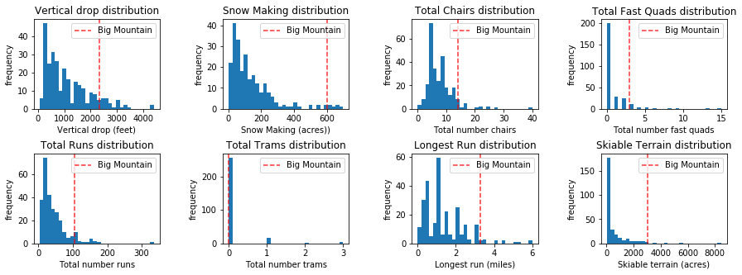
Modeling Results
Notes:
Big Mountain in comparison with Market Share on 8 most relevant features

Slide 11
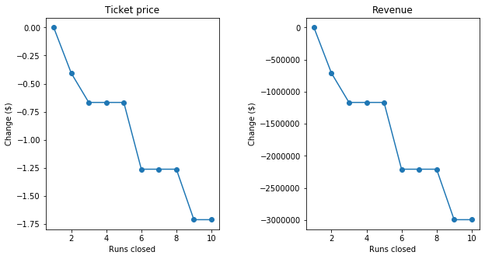
Change Scenarios
Close Runs
2. Increase Vertical Drop
add run
add lift
add 150’ vertical drop
Ticket price +$1.99
(Revenue +$3.5M)
Notes:
Discuss proposed business changes. Scenario 1: close runs. Scenario 2: increase vertical drop, w/ or w/o snow makers. Scenario 3: extend longest run w/ snowmakers - no change could be due to run already long enough or snow making increasing by too little to make a difference.

Slide 12
Summary
Big Mountain Resort is rich in many of the 8 features most associated with high-price resorts.
The resort’s current profile supports raising the ticket price between $2 - 25.
Future areas of investment should prioritize number of runs, vertical drop, and lifts (especially fast quads).

Slide 13
Q & A
This presentation has been designed using resources from PoweredTemplate.com

